Slide 1

PROFESSIONAL TRAINING PRESENTATION
SATHYABAMA INSTITUTE OF SCIENCE AND TECHNOLOGY
DEPARTMENT OF SCIENCE AND TECHNOLOGY
D. BHEEMASHANKARRAHUL
REG:-39110286

Slide 2
AMAZON WEB SERVICE BUCKET AND SNAPSHOTS
PRESETATION OUT LINE:-
Course Certificate
Introduction
Types Of Aws Storage Services
Amazon Database Services
Practical Explanation Of S3 Buckets
Practical Explanation Of Amazon Ebs
Conclusion
Refrence

Slide 3
AIM- To create and access and delete a S3 bucket and create and delete of EBS snapshots
1. INTRODUCTION-
cloud storage providers are responsible for keeping the data available and accessible, and the physical environment secured, protected, and running. Cloud Storage is a model of computer data storage in which the digital data is stored in logical pools, said to be on the cloud. The physical storage spans multiple servers(sometimes in multiple locations), and the physical environment is typically owned and managed by a hosting company. People and organizations buy or lease storage capacity from the providers to store user, organization, or application data.
Amazon Web Services (AWS) provides low-cost data storage with high durability and availability. AWS offers storage choices for backup, archiving, and disaster recovery use cases and provides block, file, and object storage.

Slide 4
Amazon Web Services (AWS) provides low-cost data storage with high durability and availability. AWS offers storage choices for backup, archiving, and disaster recovery use cases and provides block, file, and object storage.
Amazon Simple Storage Service (Amazon S3) is the most widely used object storage service and used by most of the companies, even startups to enterprise-level because of its scalability, data availability, security and performance any data stored over S3 is protected, secure and always available no matter what amount of data for a range of use cases, such as websites, mobile applications that generate lots of data, backups for applications, IoT devices, and big data analytics and all these at a very minimal cost with 99.99999999999% of durability, S3 is used as storage for many other AWS services like code commit, Streaming service, and many others.

Slide 5
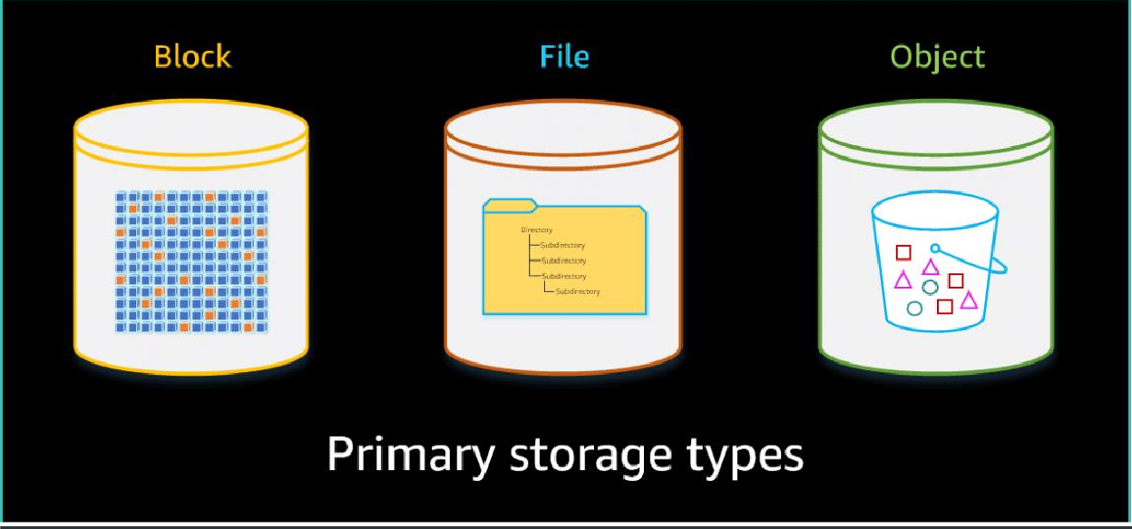
2. TYPES OF AWS STORAGE SERVICES

Slide 6
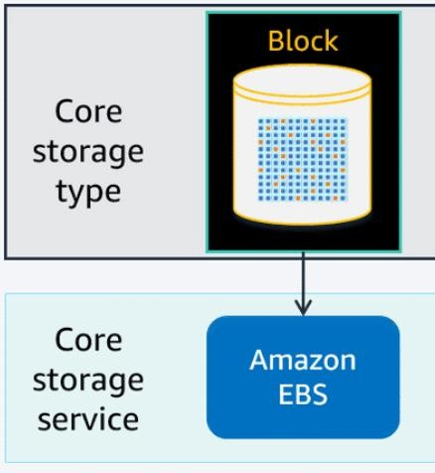
1. BLOCK STORAGE
The AWS block storage portfolio consists of two types of block storage services: Amazon Elastic Compute Cloud (Amazon EC2) instance storage and Amazon Elastic Block Store (Amazon EBS). Amazon EBS also includes an integrated snapshot service. Amazon EBS is the primary block storage service.

Slide 7
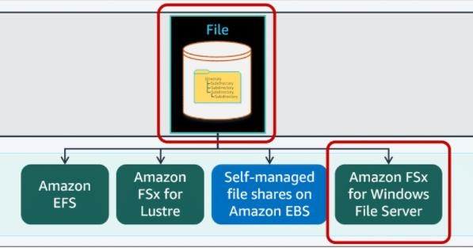
2. FILE STORAGE
AWS currently offers three different managed file storage services to meet your application, workflow, and use-case requirements. In addition, you can use Amazon EBS to create self-managed file systems.

Slide 8
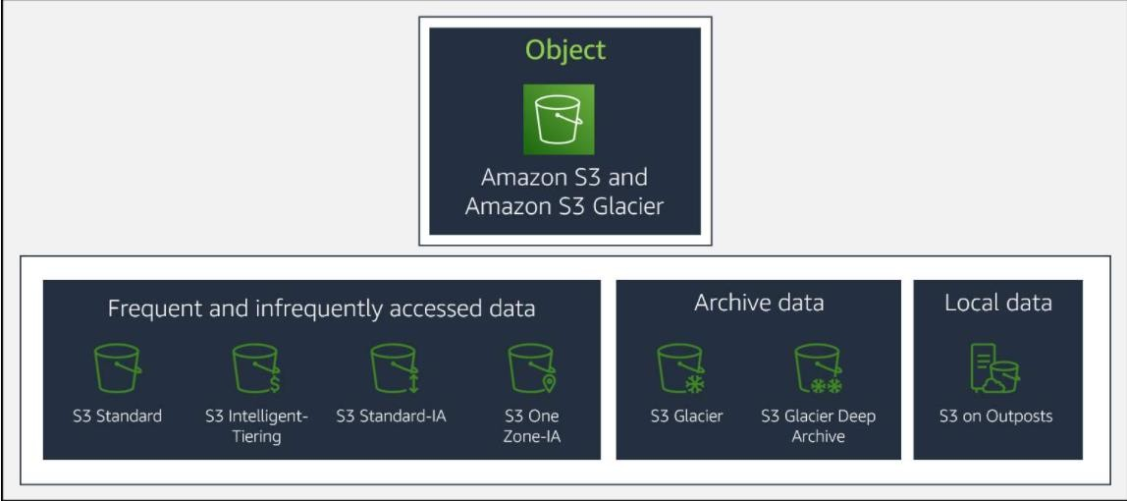
3. OBJECT STORAGE
In object storage, each object consists of data, metadata, and a key. The data might be an image, video, text document, or any other type of file. Metadata contains information about what the data is, how it is used, the object size, and so on. An object’s key is its unique identifier.

Slide 9
3. AMAZON DATABASE SERVICES
Amazon Database Services are divided into two types:
1. Amazon Relational Database Service.
2.Amazon Non-Relational Database Service.

Slide 10
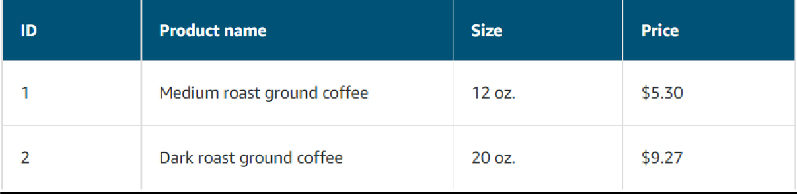
1. Amazon Relational Database Service.
Relational databases use structured query language (SQL) to store and query data. This approach allows data to be stored in an easily understandable, consistent, and scalable way.
Example of data in a relational database

Slide 11
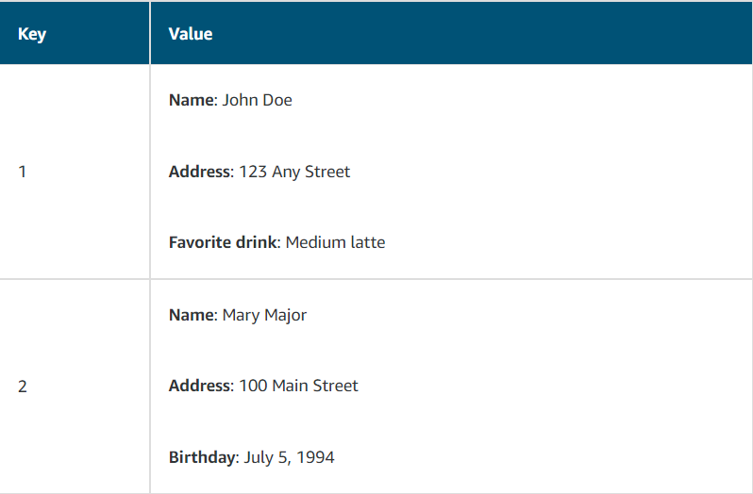
2.Amazon Non-Relational Database Service.
Nonrelational databases are sometimes referred to as “NoSQL databases” because they use structures other than rows and columns to organize data. One type of structural approach for nonrelational databases is key-value pairs. With key-value pairs, data is organized into items (keys), and items have attributes (values).
Example of data in a nonrelational database

Slide 12
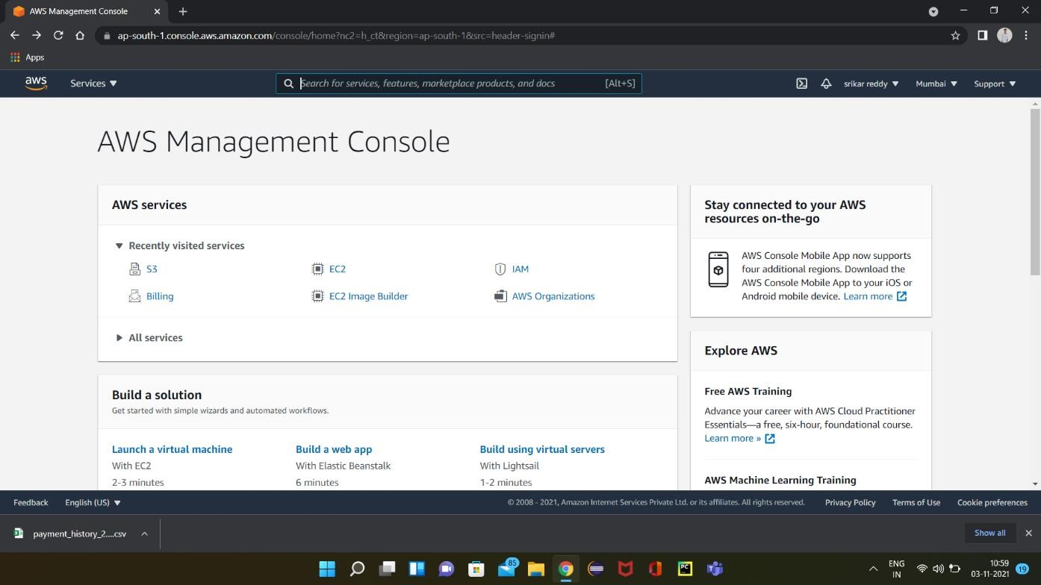
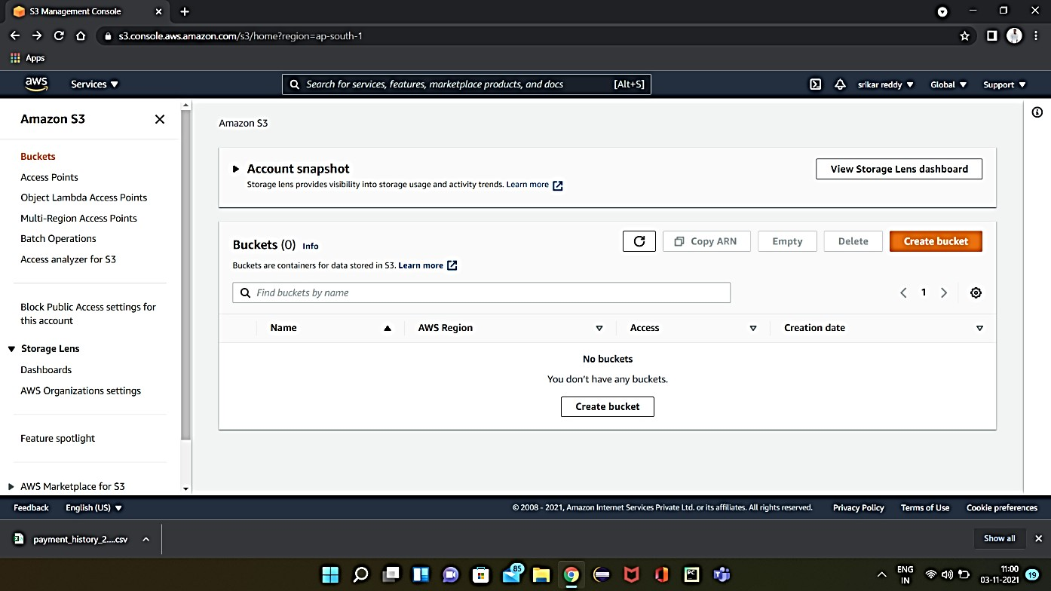
4. PRACTICAL EXPLANATION OF S3 BUCKETS
Creation of a bucket
Step 1: Select S3 from the dashboard or search it in the search bar in AWS management console.
Step 2: In Amazon S3 bucket can be created by clicking on the “Create bucket” option

Slide 13
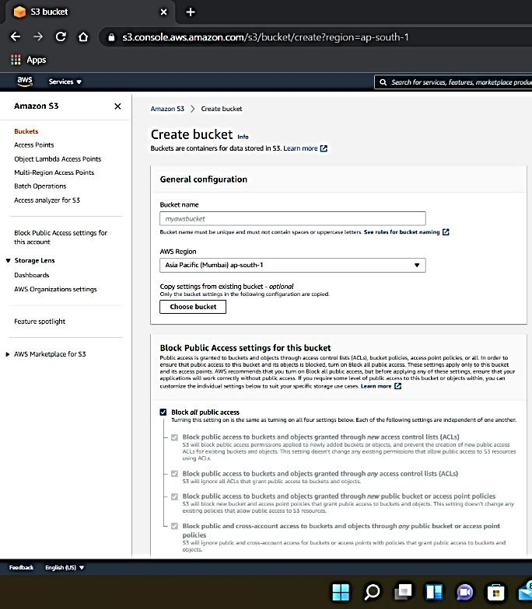
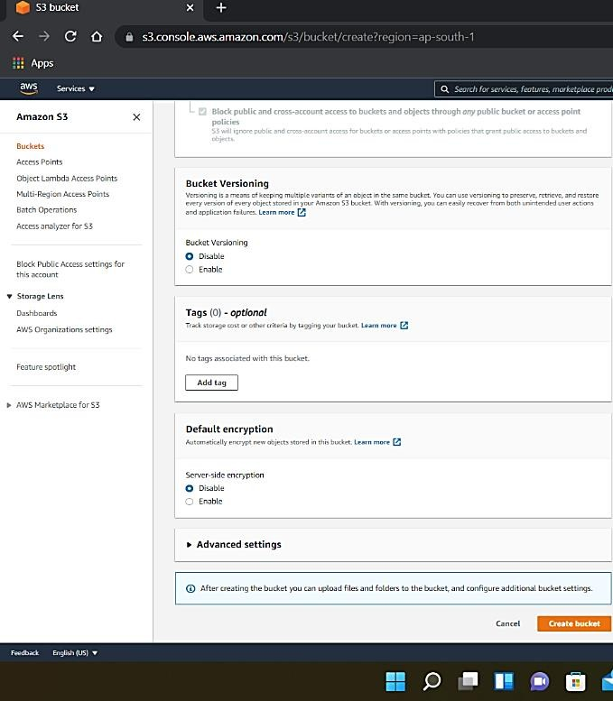
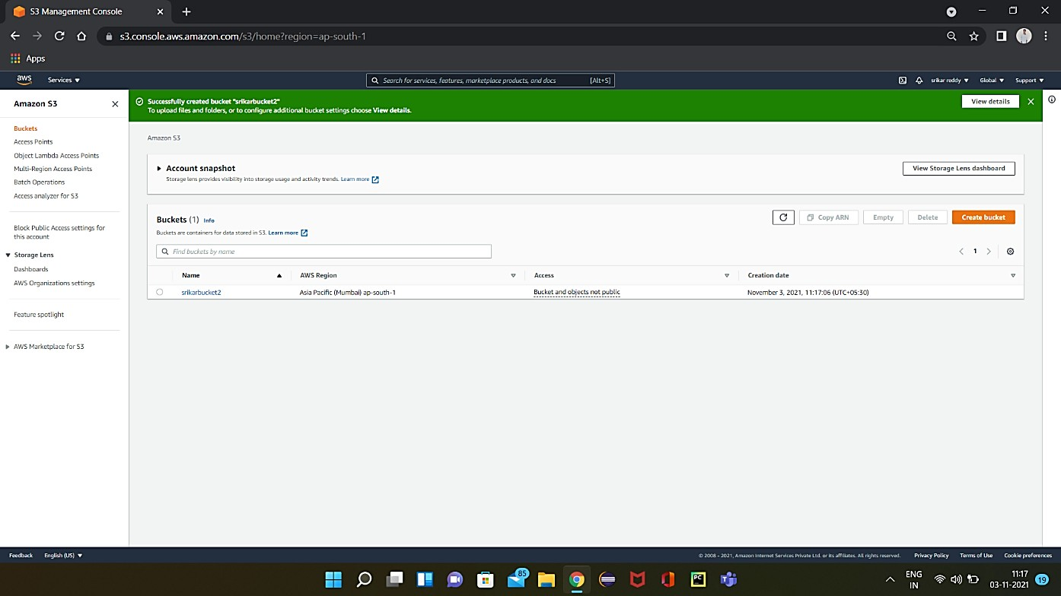
Step 3: Give a globally unique name for the bucket.
Step 4: Finally S3 bucket is created with the name given by the user.

Slide 14
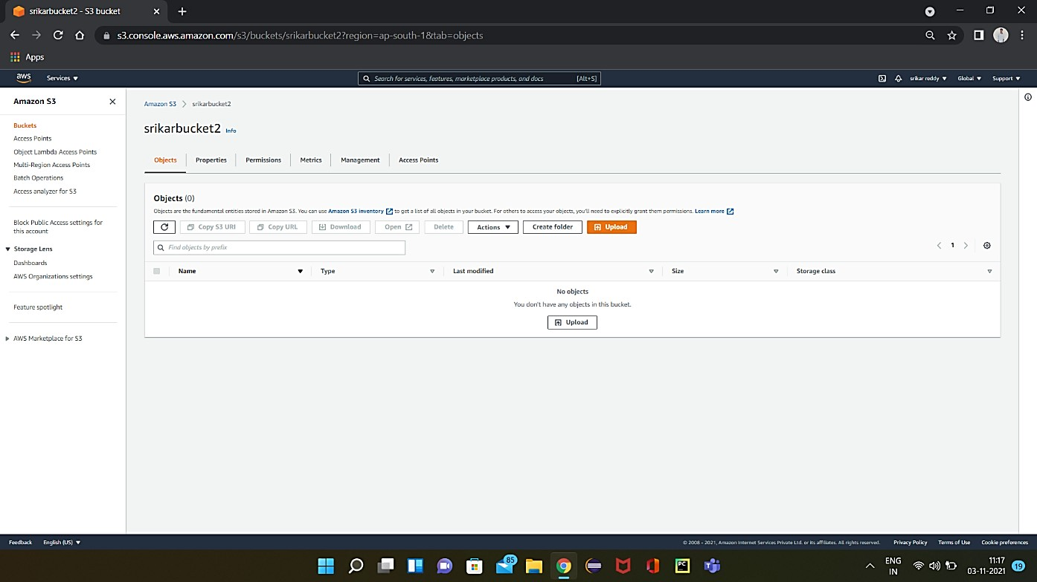
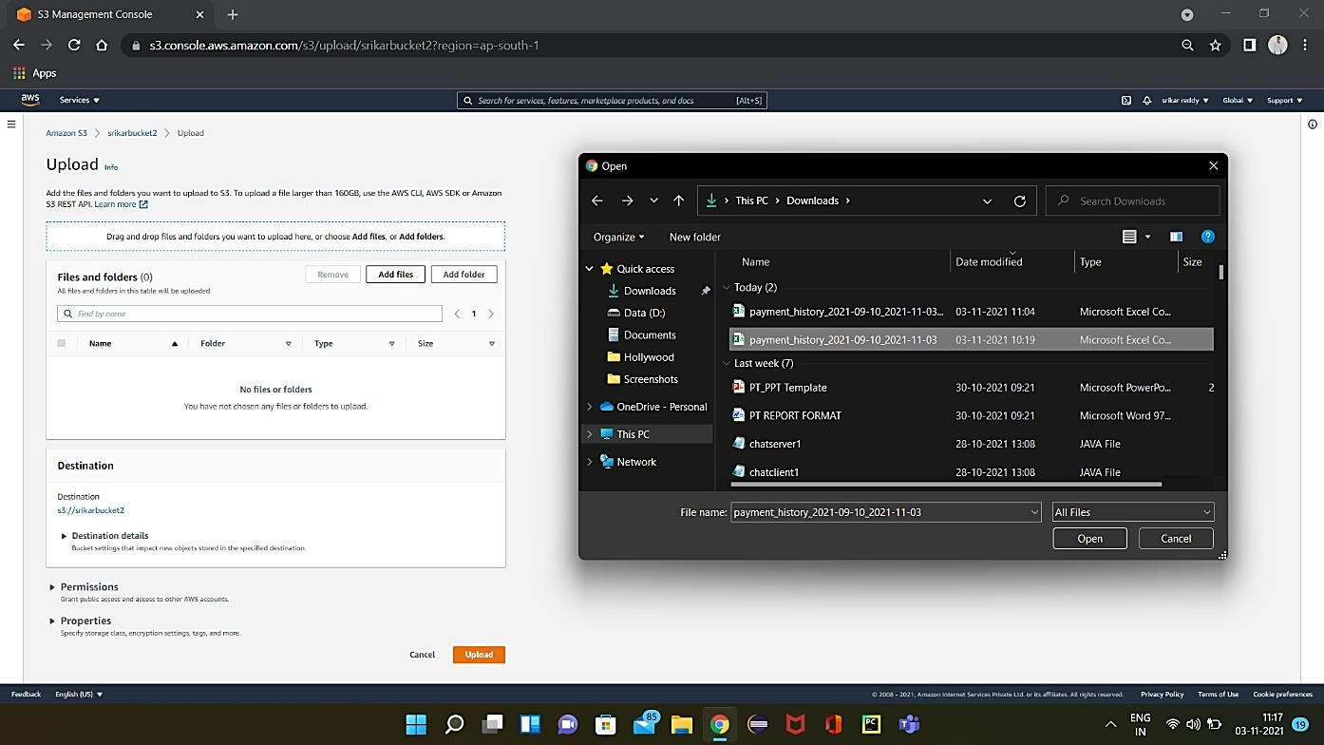
Accessing A Bucket
Step 1: To upload files in S3 bucket, click on “upload” option.
Step 2: Click on “Add files” and select the file to be added.

Slide 15
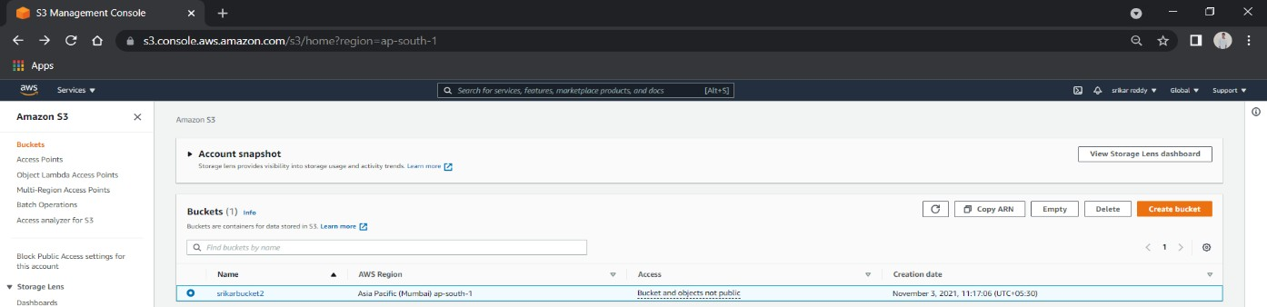
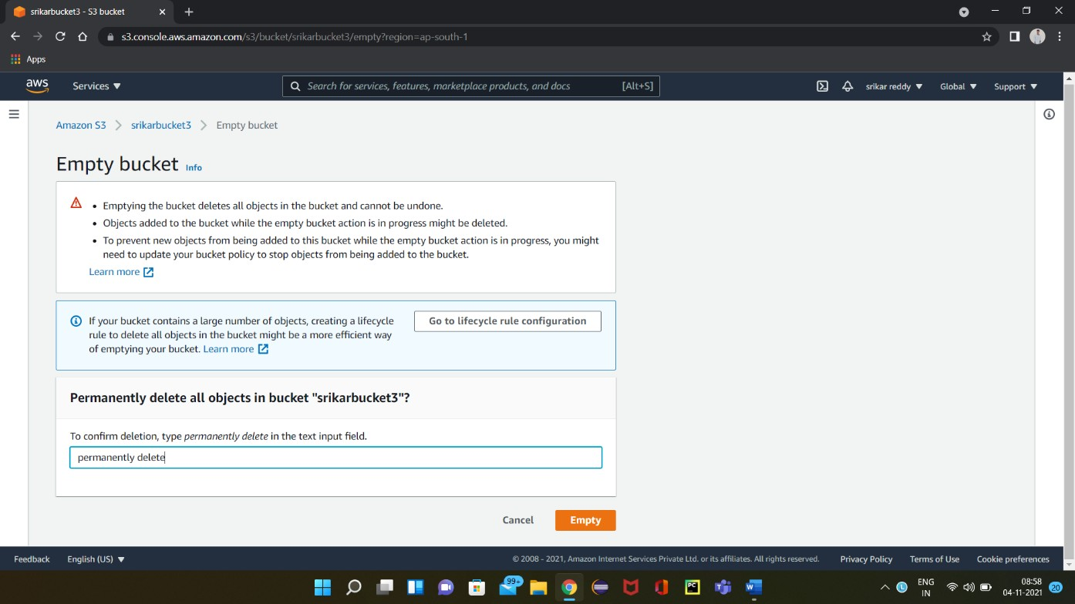
Deleting A Bucket
Step 1: To delete a bucket select the bucket to be deleted and select the “Empty” option Located on the right top of the page.

Slide 16
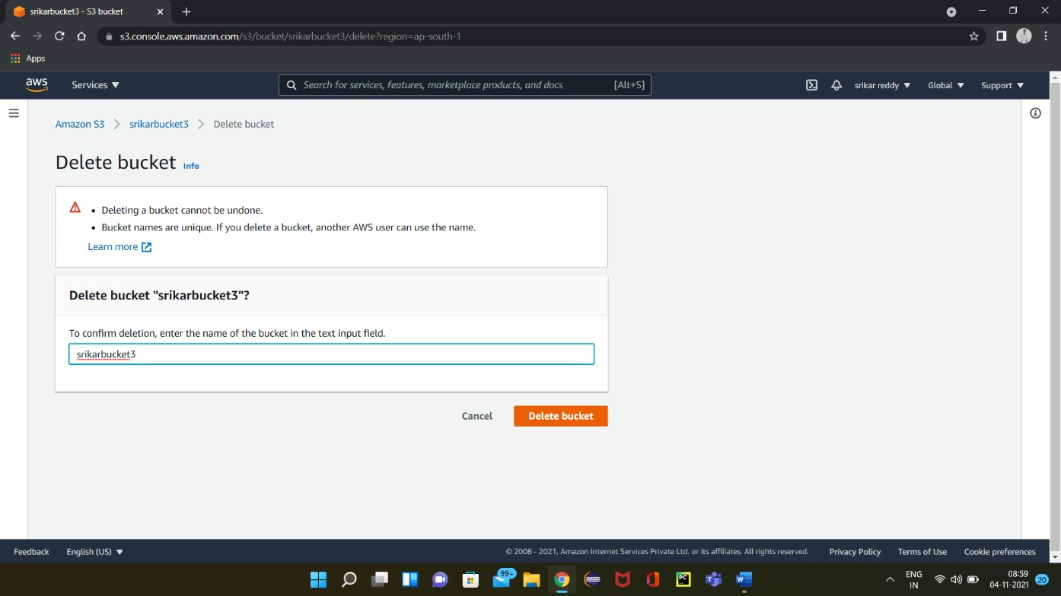
Step 2: After emptying the bucket go to the delete menu and enter the bucket name and select the option “Delete bucket”. The bucket got deleted.

Slide 17
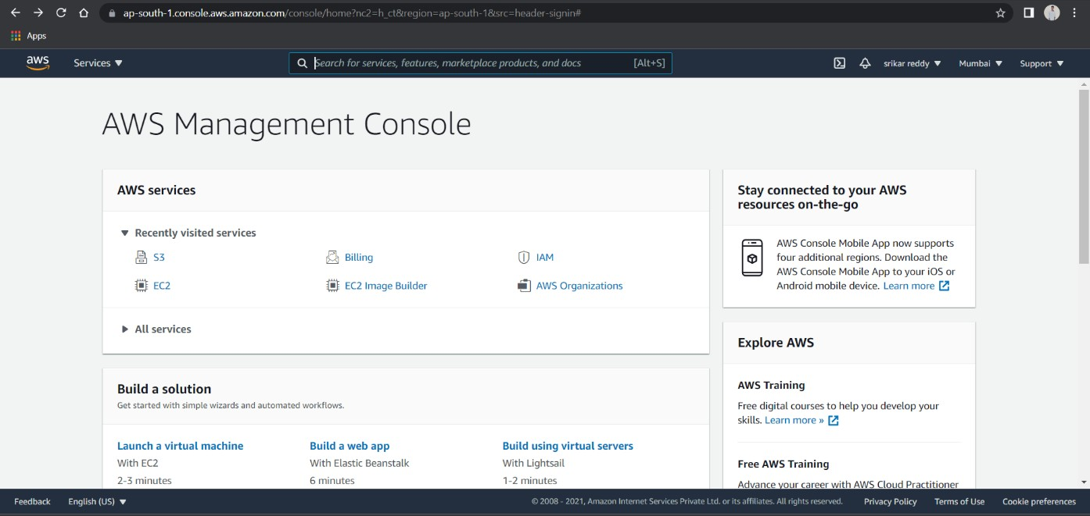
5.PRACTICAL EXPLANATION OF AMAZON EBS
Creation Of Ebs Snapshots
Step 1: For creating EBS Snapshot, go to EC2 by selecting it from management console

Slide 18
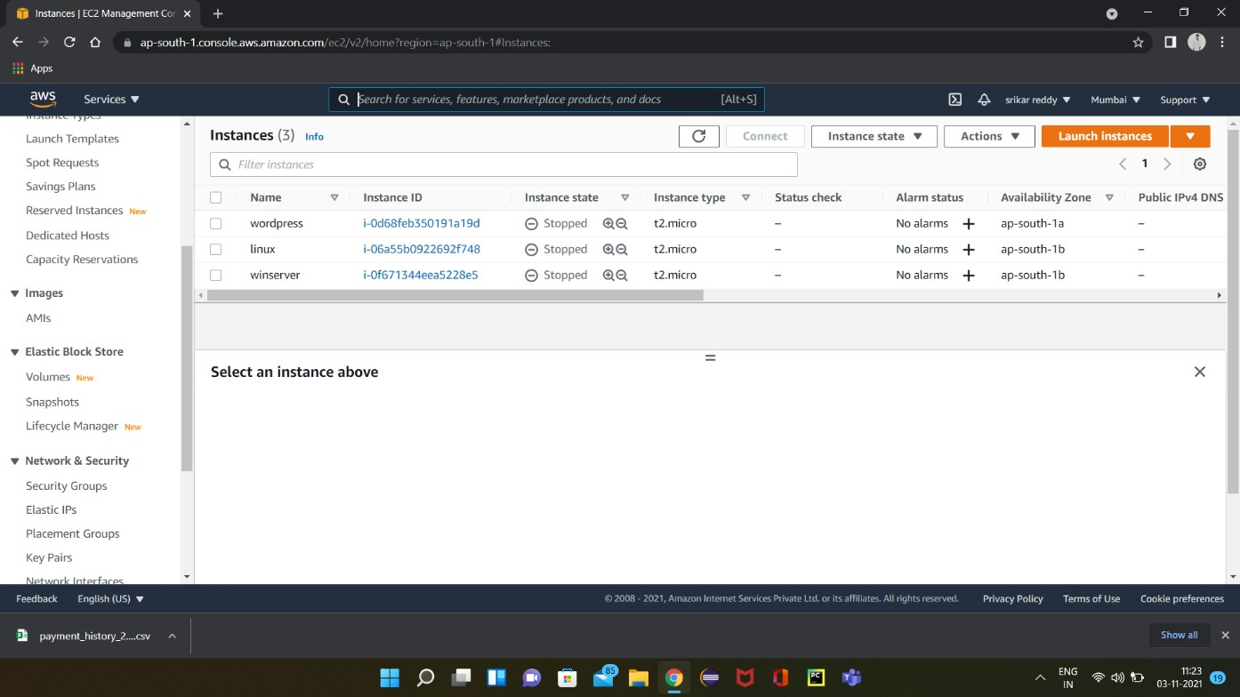

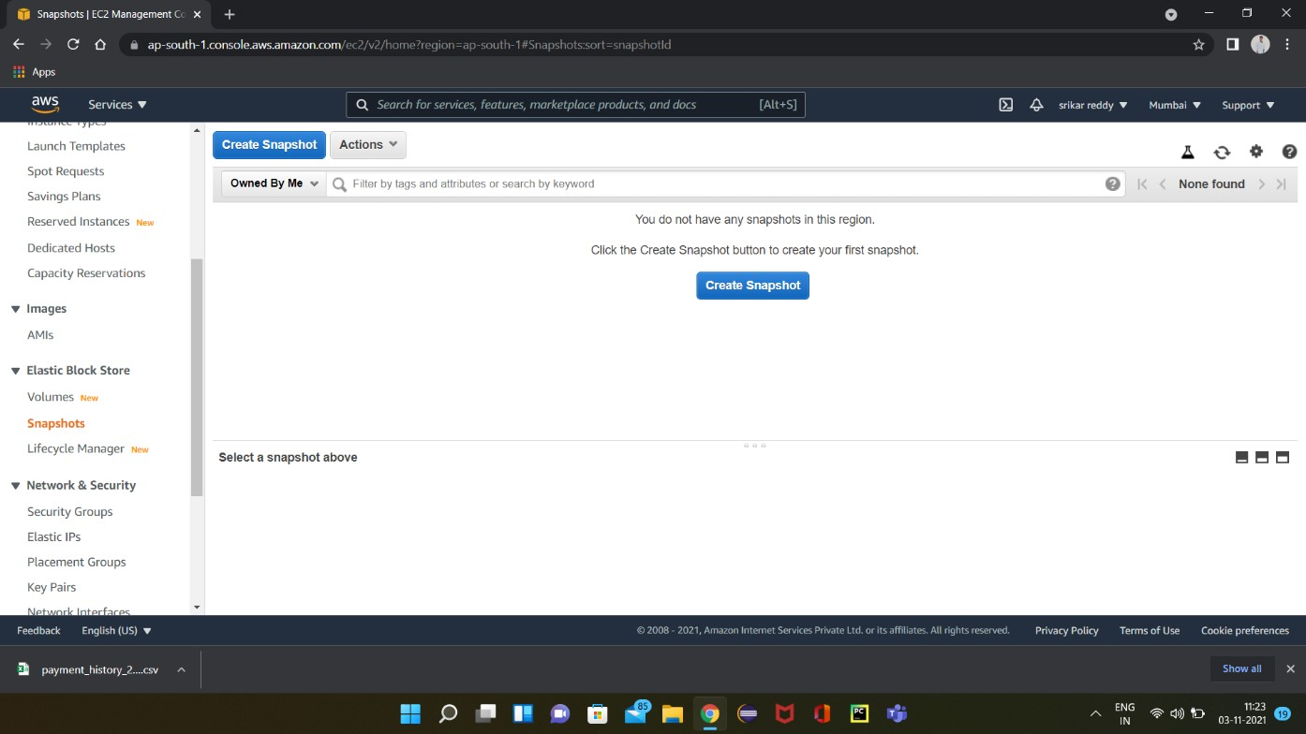


Step 2: After entering into EC2 dashboard, we can find Elastic Block Store on the left side and select snapshots.
Step 3: Select “Create snapshot” to create a new snapshot.

Slide 19
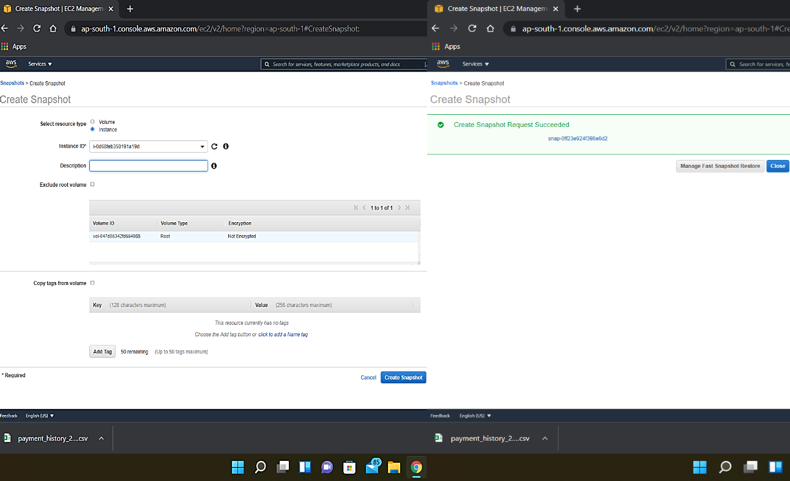
Step 4: Select the required volume or instance.Fill the blanks if necessary or leave them default and click on “Create Snapshot”.Snapshot is created

Slide 20
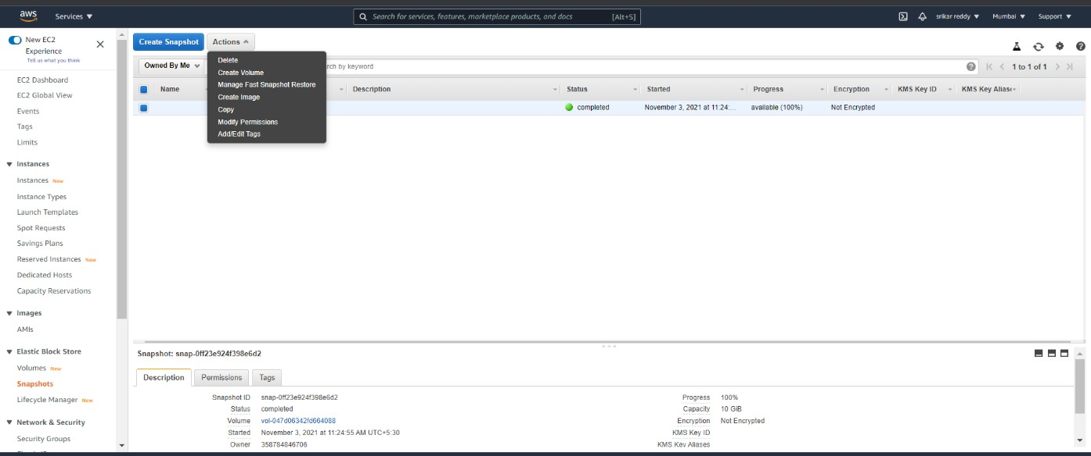

DELETION OF SNAPSHOTS
Step 1: For deleting a particular snapshot, select the snapshot.
Click on “Actions” and select “Delete” option and the snapshot gets deleted

Slide 21
6.CONCLUSION
Cloud storage is an emerging technology and has a great changing impact on the way businesses and organizations manage their information and data. Cloud storage provides massive scalability, high performance, data resiliency, and 99.999% readability. Cloud storage is a critical component of cloud computing because it holds the information used by applications. Big data analytics, data warehouses, Internet of Things, databases, and backup and archive applications all rely on some form of data storage architecture.
AWS offers a complete range of cloud storage services to support both application and archival compliance requirements. Select from object file, and block storage services as well as cloud data migration options to start designing the foundation of your cloud IT environment.

Slide 22
7.REFERENCES
1. Mohd Tajammul, Iftikhar Aslam Tayubi, Rafat Praveen, ”Cloud Storage in Context of Amazon Web Services”, Volume 10, Issue 01-january-2021, page no:442-446.
https://www.ijert.org/cloud-storage-in-context-of-amazon-web-services
2. AWS Skill builder:
https://explore.skillbuilder.aws/learn/course/6233/play/19879/core-aws- storage-services;lp=93
3. Star Cloud Computing-Star Certification https://elearning.starcertification.org/pluginfile.php/34086/mod_resource/content/1/Cloud%20Computing%20for%20LMS/Index.html#/reader/cha pter/54?vi=0

